Slide 1

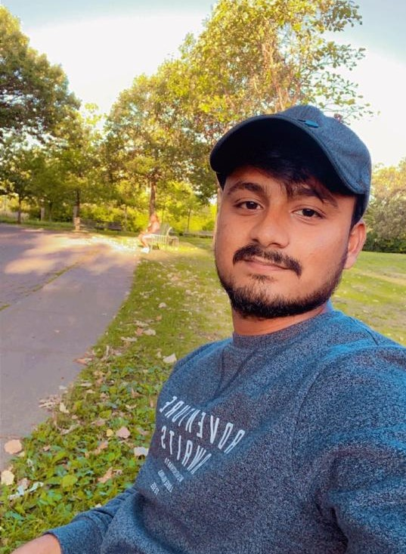

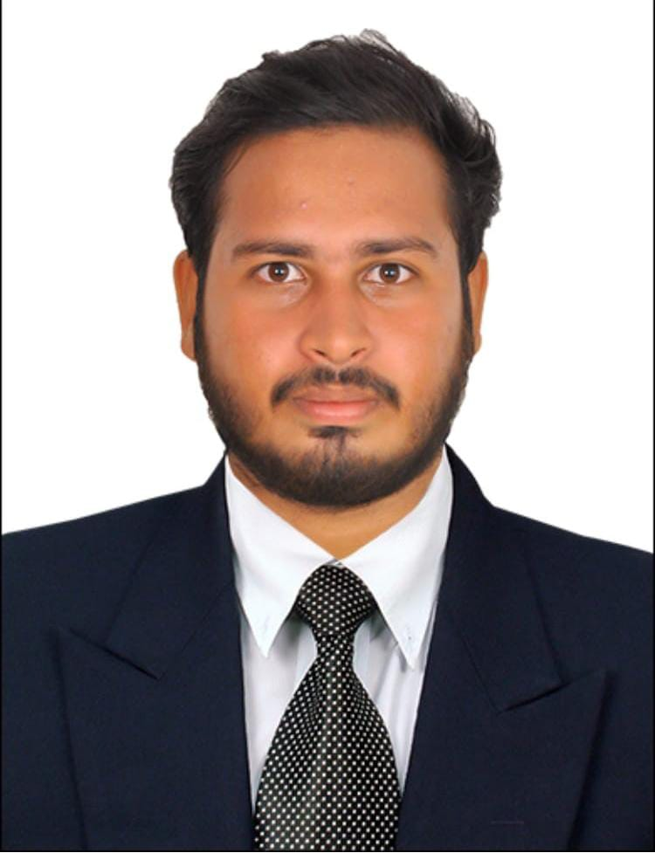


TOURISM MANAGEMENT SYSTEM
Ajay Kumar Chavvakula
Service interation and Development
Vadde Narendarnath Sai
Database and schema Development
Harshavardhan Reddy Yaramala
Web Development
Pranay Vatte
Cloud backend and development
Target Market
Tourist agency for saving customer details
Planning trip (group/single)
Workspace for managing the cost of the trip
who are looking for managing the whole trip together
Distributed web base application can integrate agencies of different location to manage easily by providing services for customers at different locations of various cites.

Slide 2

PAIN POINTS
The ticket window on holidays is under pressure(queuing to buy tickets)
High cost of online operation and promotion
Unable to collect travel information
Some guides run rampant
Difficulty to stay in touch with people in the office for managing tour (offline)
Need to search travelling information , accommodation and food in different sectors makes disappointment to manage the tour

Slide 3
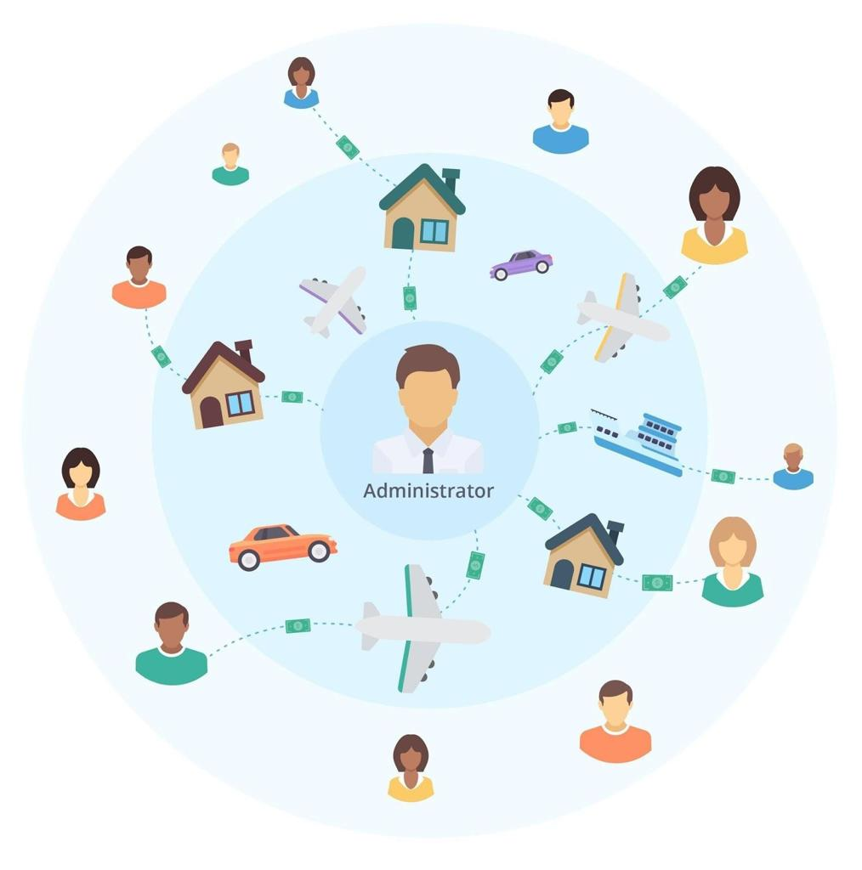
HOW TO SATISFY PAIN POINTS
RESOLVING CUSTOMER COMPLAINTS
To have effective complaint resolution , managers must empower frontline service employers .
to give them authority responsibility and incentives they need to recognize , care about and tend to customer needs to Resolving customer complaints is a critical component of customer retention.
A study by the technical research programs institute found that if a customer has a major complaint ,91 percent will not buy from you again, but if it was resolved quickly 82 percent of those customers will return.

Slide 4
KEY WINNING FEATUERS
TRAVELLING INFORMATION
It can save the whole travelling information that helps to maintain a good register in online and it also available all the time wen you need to check it out.
MANAGING THE LOCATION
There is no need to be in the queue for buying tickets of surrounding places wherever you go ,you just need to add the surrounding locations to the primary location and your allowed to buy tickets online.
BOOKING HOTEL AND FOOD
Once your booking done for the tour ,it allows you to book hotels and food online .
BOOKING VEHICLE
Booking vehicle is the most expensive thing in real time when your going to tour in offline ,so this management system overcomes this issue and solved with showing from the lowest fares to book vehicle and the fares are depends on the vehicle you choose.
SECURITY
It is mandatory that everyone should register and have user id and password to book the tour so it is secured.

Slide 5
CAPABILITIES
Travelling information shows all the travelling information i.e; records.
Managing location by adding surrounding places to the particular location and with images and description i.e; history.
Booking hotel and food is giving you the easy way to finish your trip along with tourism tickets.
Booking vehicle is the most challenging task to reach the location , so this feature allows you to book the vehicle with in the package.
Security which means all the tickets and codes will be transferred to your mail and mobile after confirmation.

Slide 6
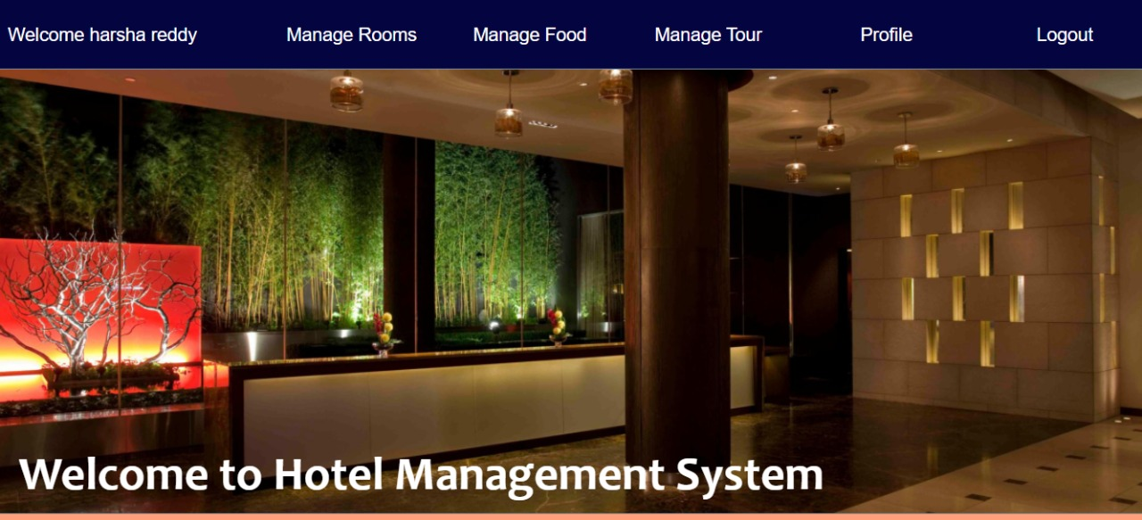
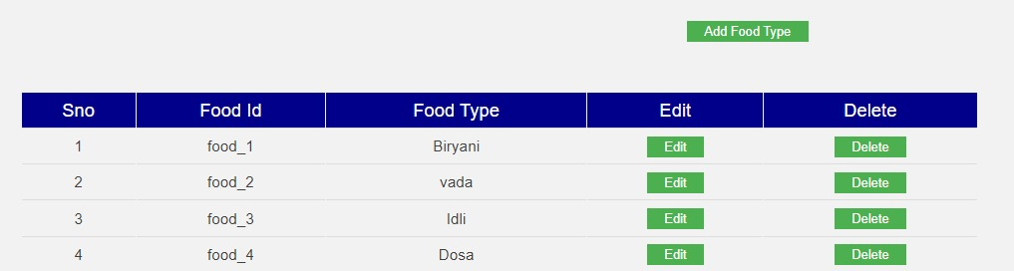
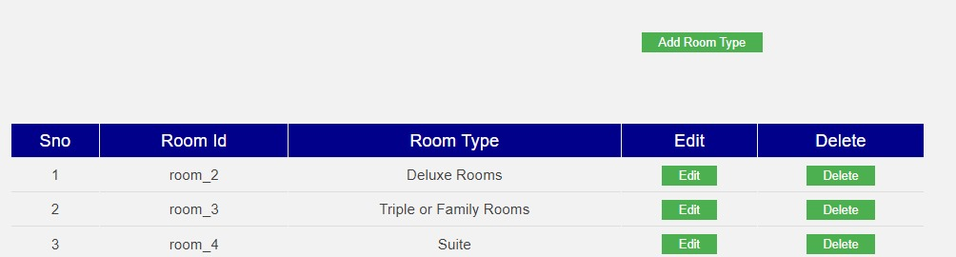
CURRENT STATUS AND PROTOTYPE
ADMIN PAGE

Slide 7
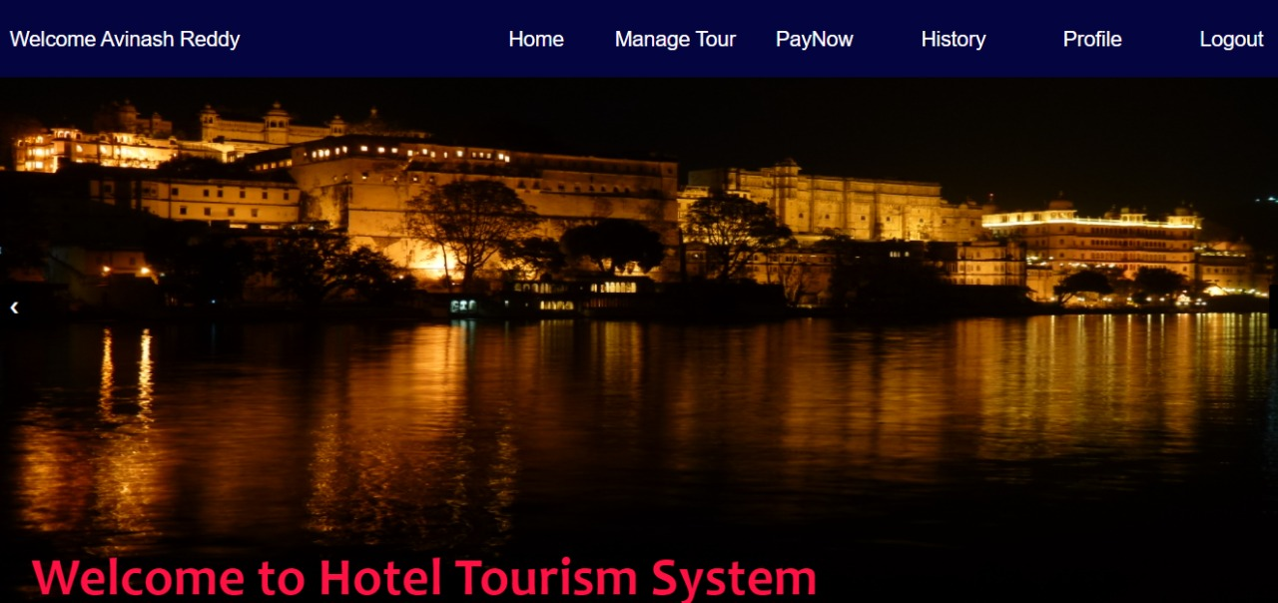
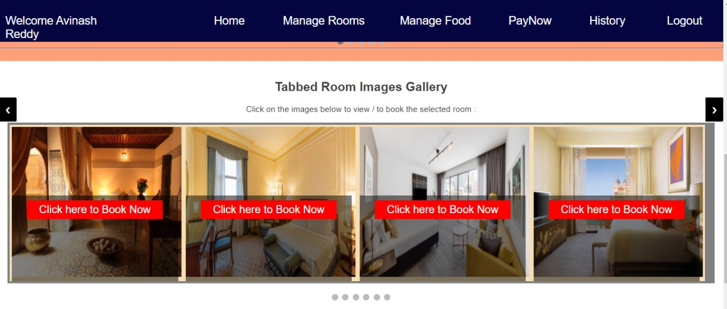
User Page

Slide 8
DEMO VIDEO

Slide 9
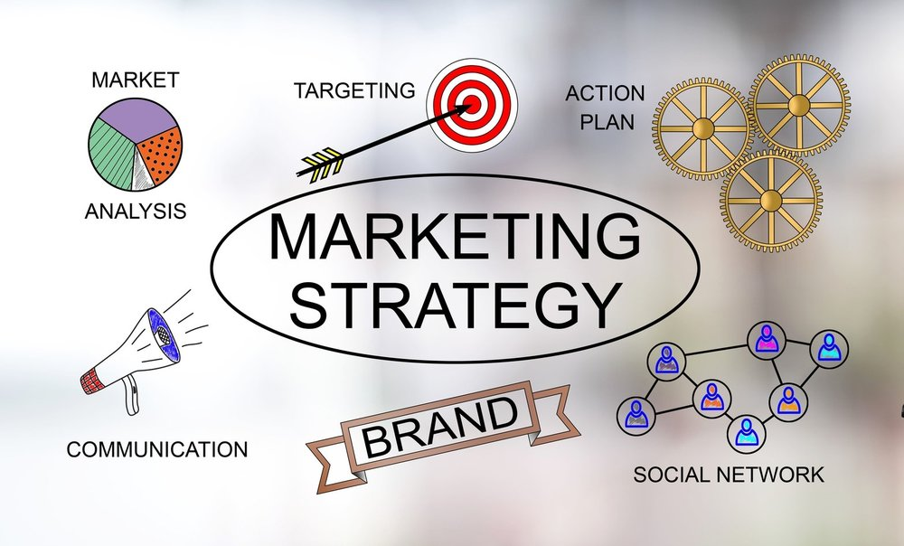
HOW YOU ARE GOING TO MAKE MONEY
We will attract investors from social media platforms.
We tie up with some of the leading travelling companies.
we make some offers for the investor and also the user.

Slide 10
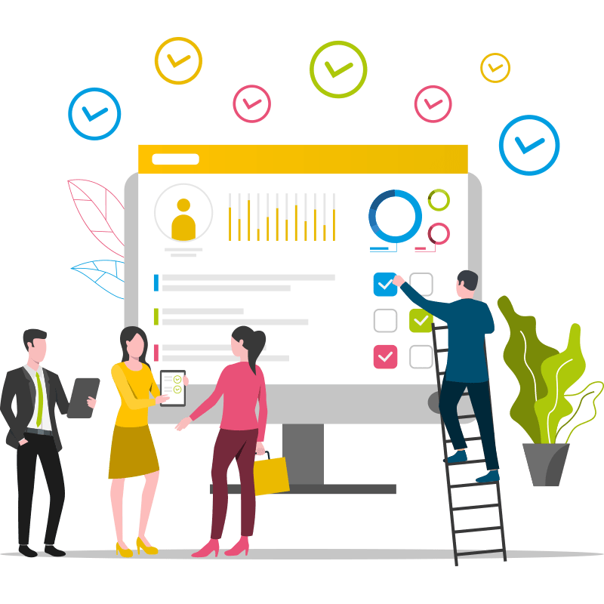
PLAN FOR IMPLEMENTATION
People see holidays as a necessity and not as luxury in the present scenario.
Introduce cost-effective monitoring programmers to measure the condition, performance and impact of tourism.
Any system developed must not have a high demand on the available technical resources. This will lead to high demands on the available technical resources.
This will lead to high demands being placed on the client. The developed system must have a modest requirement, as only minimal or null changes are required for implementing this system.

Slide 11
THANK YOU

